Slide 1
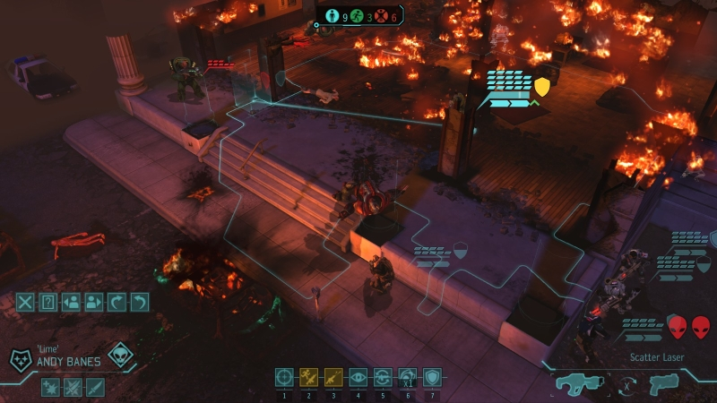
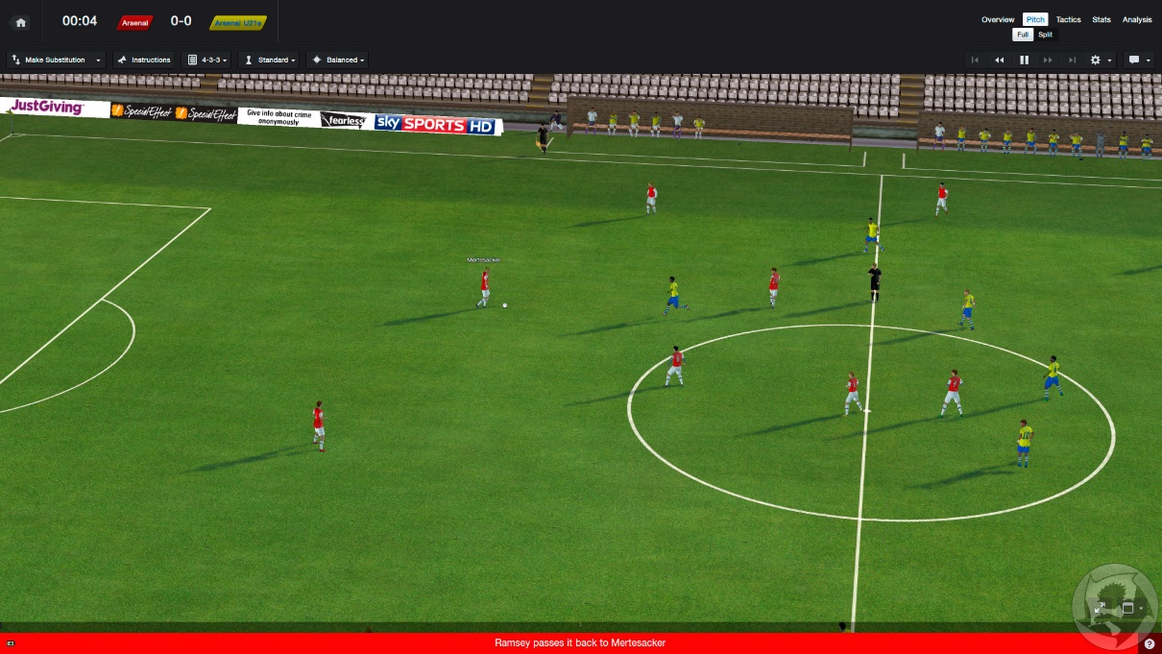
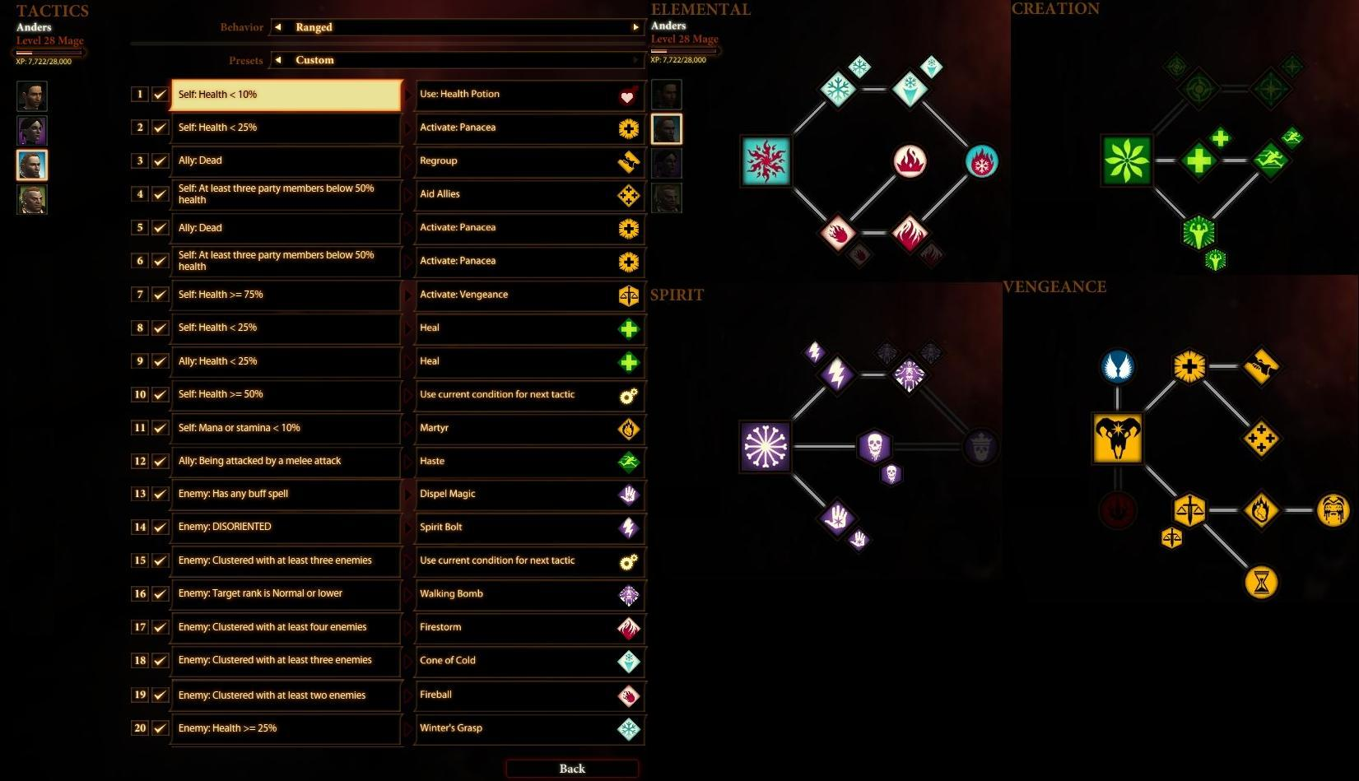
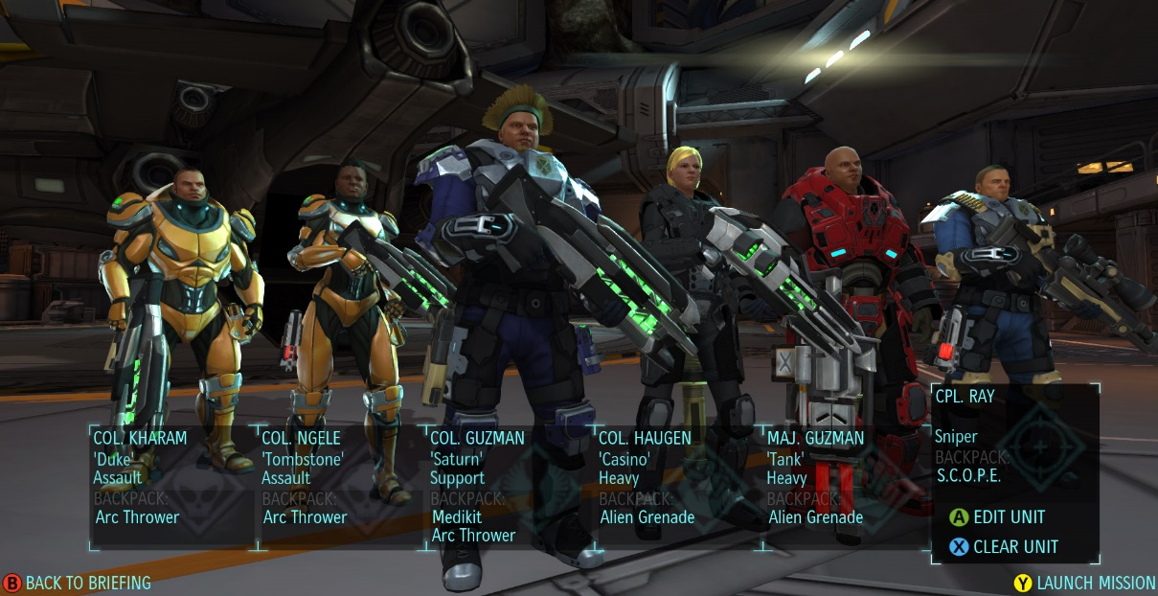
Reference
XCOM
Customization and Assembly
Football Manager
Automatic Core Mechanic
Dragon Age
Tactic Book

Slide 2
Design
Character
Equipment
Skill
Tactic
Terrain

Slide 3


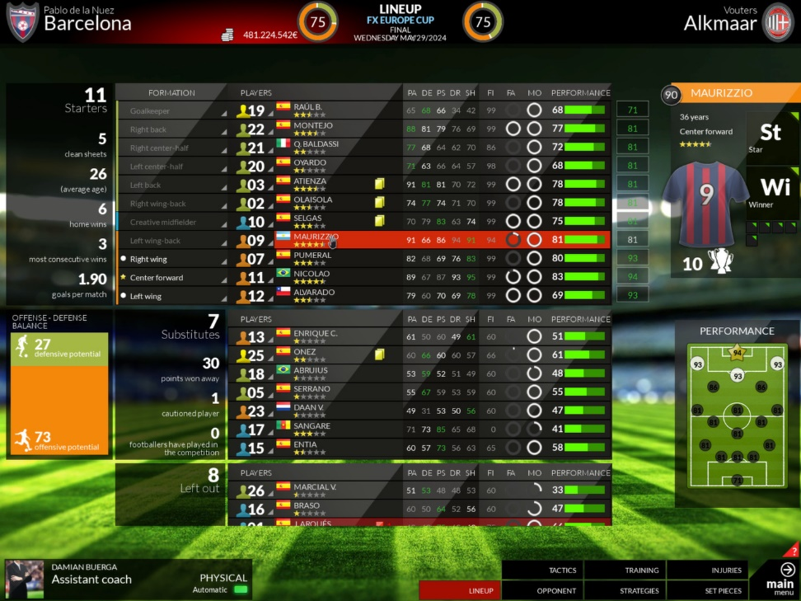
Art
Cubic
Simplism UI
Dissociate Effect

Slide 4
Tech
Tactic Grammar
Tactic Engine
Atomic Cube & Effect

Slide 5
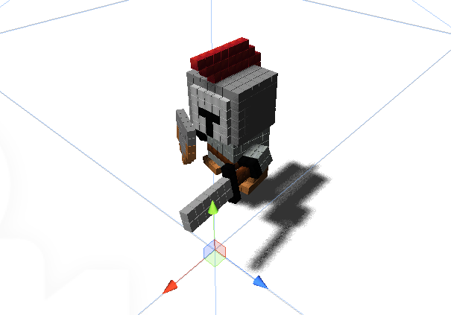
Production
Deathwave
Energy Shield
Flame Aura
Flexibility
Fireball
Ice Blast
Blizzard
Blink
Skill
Convertibility

Slide 6
Thank You!

